Slide 1
Quarterly Retail Reports and Trends
Q3 2025

Slide 2
Generational
Inflation
Shopping/Trip patterns
At home vs. away from home spend
Online grocery spending
Topics

Slide 3
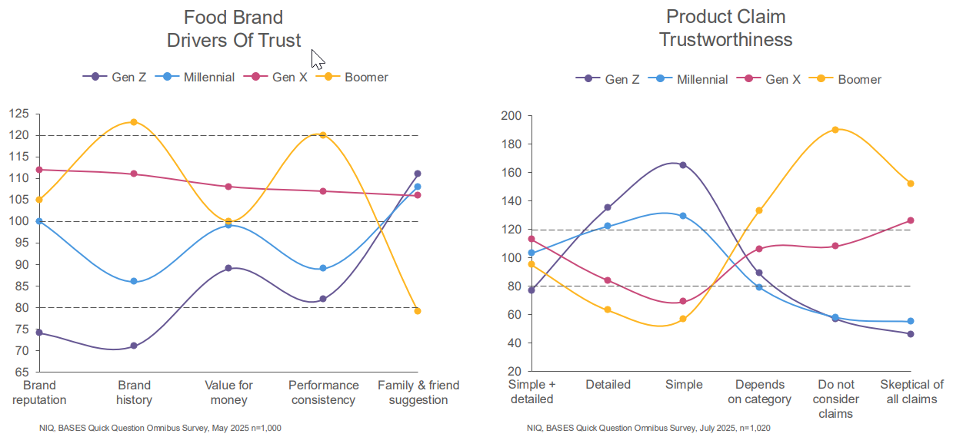
Generational
Most generations use family/friend recommendation to determine trust in brands; however, Boomers are more swayed by consistency and brand history
Boomers are also more skeptical of food claims than other generations

Slide 4
Inflation Perceptions
Grocery is the place most are feel they are seeing inflation in their day-to-day lives currently
Q: In the past 6 months, at which of the following venues have you noticed price increases?
Source: Provoke Insights Summer 2025

Slide 5
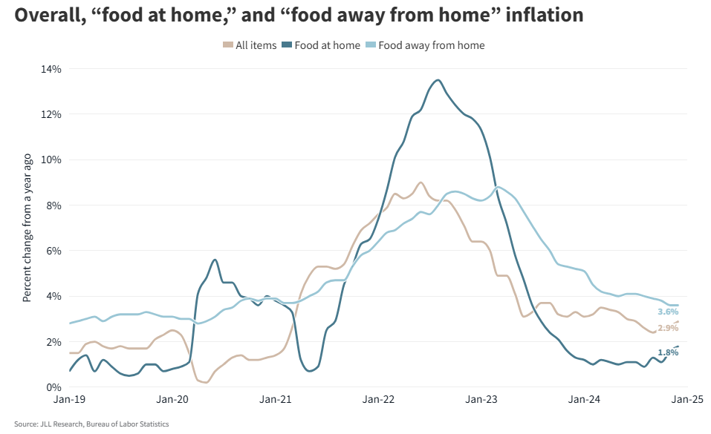
Inflation Trend
In actuality, restaurant inflation has outpaced grocery inflation for some time now

Slide 6
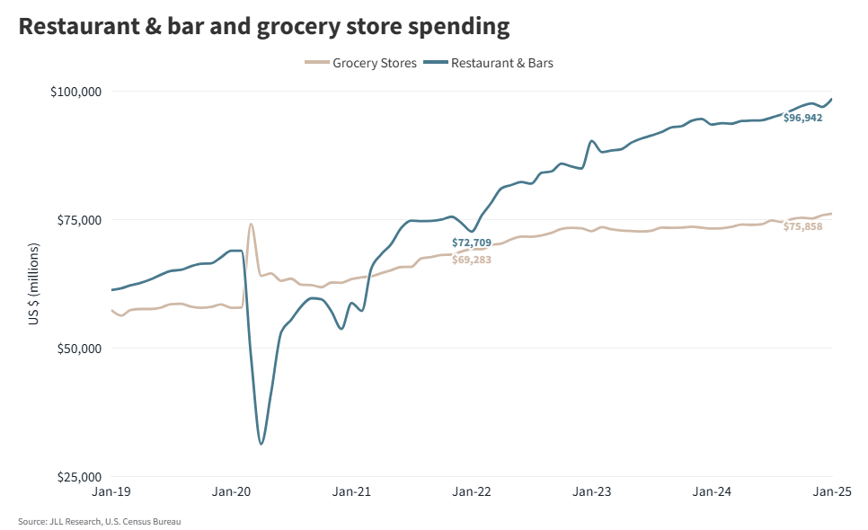
At Home vs. Away From Home Spend
With perceived grocery inflation high, many are viewing eating out as a value, largely due to the convenience and experience vs. cooking

Slide 7
Shopping Patterns
Source: Provoke Insights Summer 2025

Slide 8
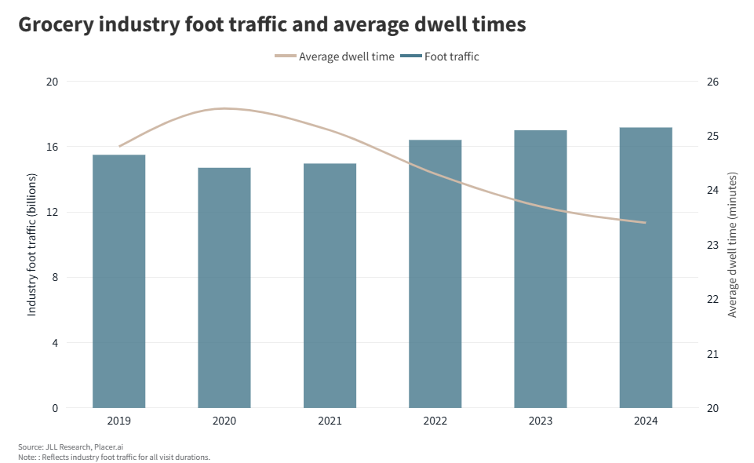
Shopping Trip Details
Shoppers are making more trips to the grocery store but spending less time in-store. Some of this is attributed to online shopping, as well as some shoppers visiting multiple stores for deals

Slide 9
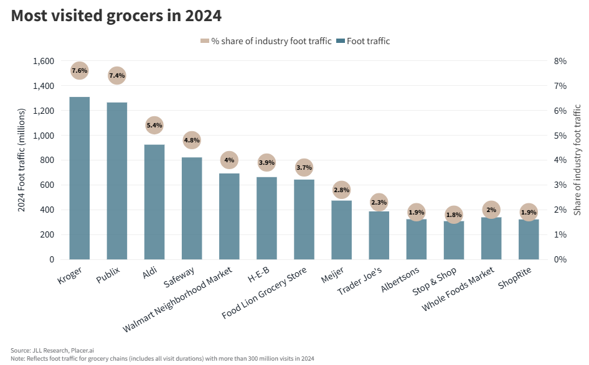
Retailer Specific Visits
The top 10 most visited grocers accounted for nearly 44% of total grocery industry visit share in 2024

Slide 10
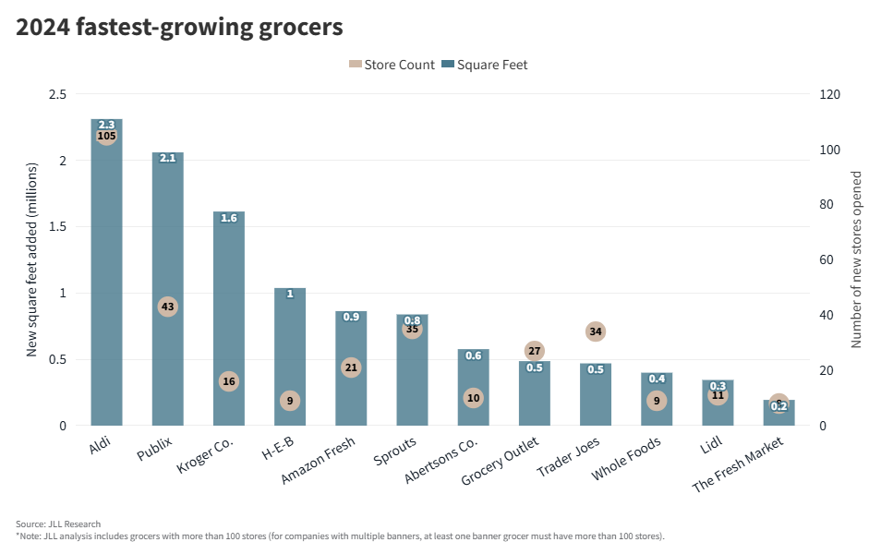
Fastest Growing Grocers
In terms of store count and square feet, Aldi and Publix were the fastest growing chains in 2024

Slide 11
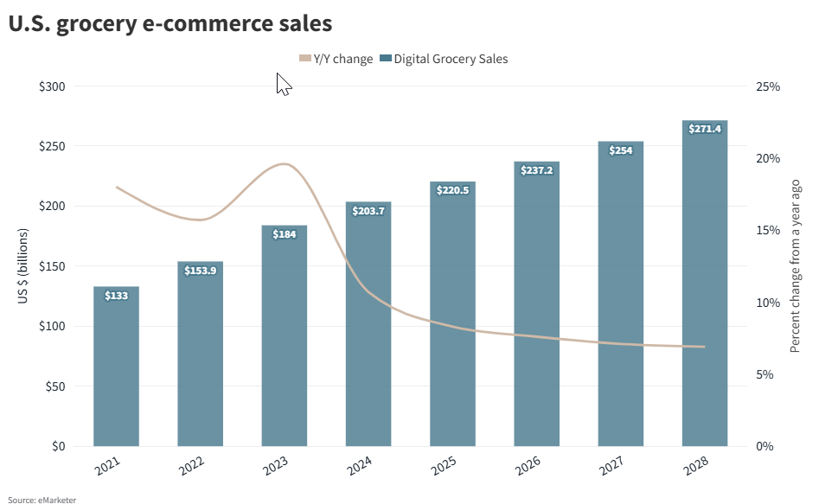
Online Grocery Spending

Slide 12
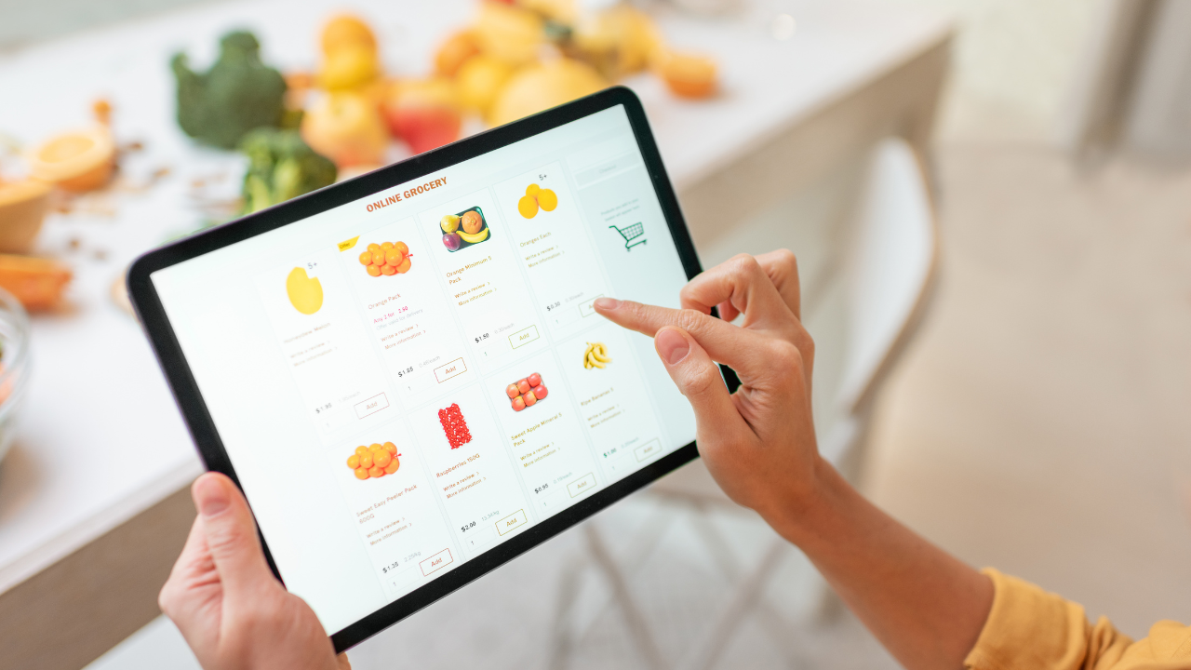
Online Grocery Shopping
81M households, or 61% made an online grocery purchase in July, a record high
Led to a 26% increase in spending, and 17% of total grocery sales for the month
Online grocery sales are projected to grow at a rate of 8.9% over the next 5 years
Delivery is the top method of fulfillment, followed by pick-up, and then ship-to-home, though all three grew year-over-year
The growth is mostly coming from those aged 30-60
Source: https://www.supermarketnews.com/grocery-technology/online-grocery-shopping-is-at-an-all-time-high

Slide 13
Thank You
For any questions, or for further detail on any topics, please email
Ryan.Barnett@Seaboardfoods.com

